Slide 1



College enquiry Chatbot
Guided by:
Mr Sivadas T Nair
Assistant Professor
Artificial Intelligence And Data Science
Group members :
Vivek Raj (VJC21AD054)
Anirudh p sudhy (VJC21AD012)
Aaditya krishna (VJC21AD001)
Bastin george (VJC21AD021)

Slide 2
PROBLEM STATEMENT
Institutions of higher education often struggle with providing easily accessible and user-friendly methods for students, faculties and parents to access essential information about the college.
We have developed a Chatbot AMANDA which enhances the accessibility of college related information.
It provides a user-friendly interface that allows users to interact and obtain the necessary details effortlessly.
By implementing AMANDA, colleges can improve user satisfaction, reduce the burden on administrative staff, and ultimately enhance the overall experience for students and prospective students.
AMANDA could be integrated with any college website by training with the corresponding college data.

Slide 3

ABSTRACT
Through the implementation of this chatbot, we aim to address the challenge of accessibility and user-friendliness in accessing college-related information.
Front-end technologies such as HTML and CSS are put in to work for the user interface.
Back-end technologies including Python and the Flask framework for implementation.
The chatbot utilizes various Python libraries and modules, including Flask, Redirect, MySQL Connector, and ChatterBot, to facilitate seamless communication and information retrieval.

Slide 4
LITERATURE SURVEY
TITLE | METHODOLOGY | ADVANTAGES | DISADVANTAGES
A review on college enquiry chatbot | Python libraries and modules, including Flask, Redirect, MySQL Connector, and ChatterBot, to facilitate seamless communication and information retrieval. | User friendly interface so makes it easy even for new users to interact with the chatbot and creates a pleasant atmosphere altogether. | Backend work using html has to be continuously monitored in order to change and insert new queries.
Literature Survey on College Information Chatbot | The methodology involves natural language understanding and conversation management methodologies, utilizing Rasa NLU to identify intent and extract entities and Rasa core for conversation management. | Rasa is helpful when machine learning capabilities are used thoroughly throughout the project. | Rasa requires a good understanding of natural language processing (NLP) concepts, machine learning, and the Rasa framework itself which requires deep knowledge.

Slide 5
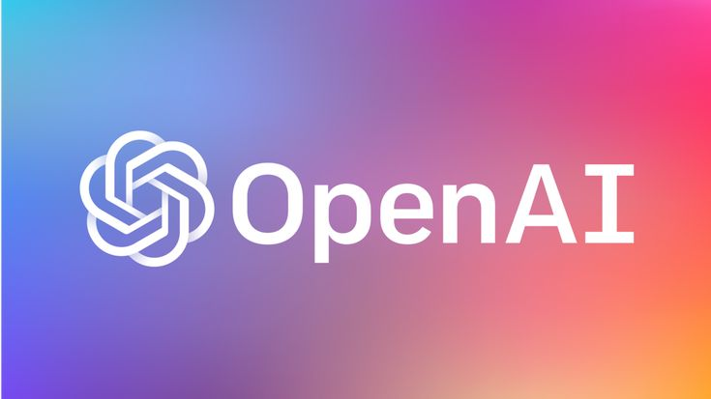

References
Brereton, E.: Universities Use AI Chatbots to Improve Student Services. EdTech Magazine.Erin Brereton , October 25, 2019
Microsoft Research: Responsible bots: 10 guidelines for developers of conversational AI.Official Microsoft blog, November 14 ,2018

Slide 6
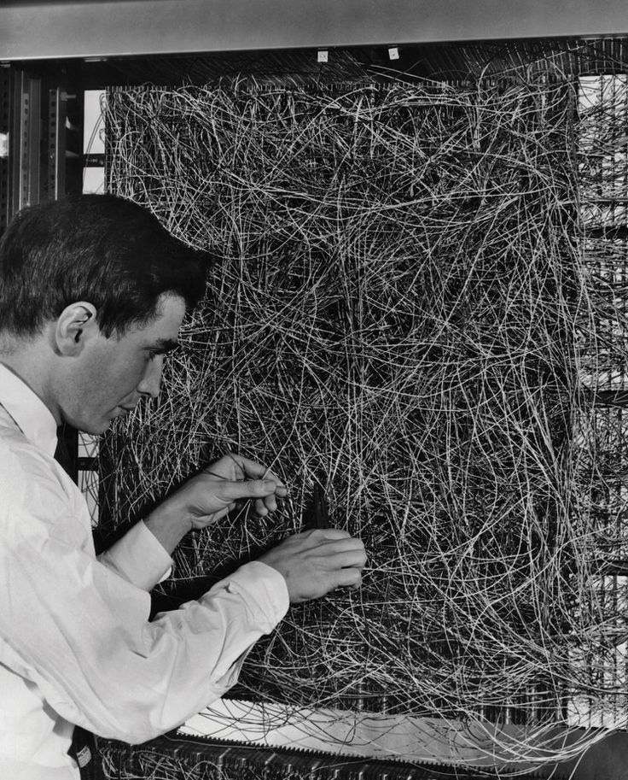
ALGORITHM
A[Start] --> B{User Actions};
B -->|Login| C[Login Page];
B -->|Register| D[Registration Page];
B -->|Forgot Password| E[Forgot Password Page];
B -->|Interaction| F[Chat Interface];
C -->|Submit| G[Login Validation];
G -->|Valid| H[Main Page];
G -->|Invalid| I[Login Page];
D -->|Submit| J[Add User];
J --> K[Login];
E -->|Submit|
L[Send Password Reset Email];
L --> M[Forgot Password Confirmation Page];
F -->|User Input| N[ChatBot Response];
N --> F;
F -->|Logout| O[Logout];
H -->|Logout| O; O --> B;

Slide 7
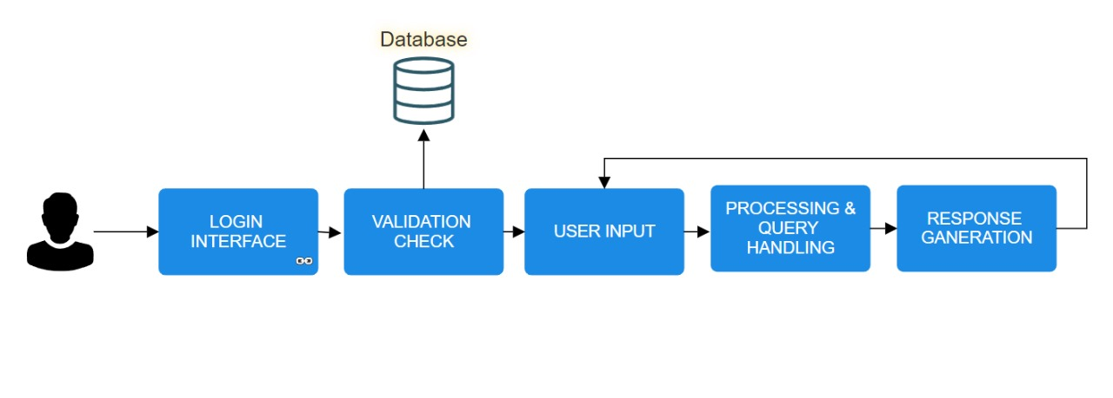
Modules

Slide 8

1. LOGIN INTERFACE
This part involves creating HTML templates (e.g., login.html) to present a user-friendly login form where users can enter their credentials (email and password) to access the system.
Here's a brief explanation of the four HTML files used in the user interface:
login.html: This page provides a form for user login, capturing email and password details for authentication.
register.html: It offers a form for user registration, gathering name, email, and password details.
forgot.html: This page presents a form for users who forgot their password, allowing them to reset it.
index.html: The main dashboard after login, displaying relevant information and functionalities based on user roles or actions.

Slide 9

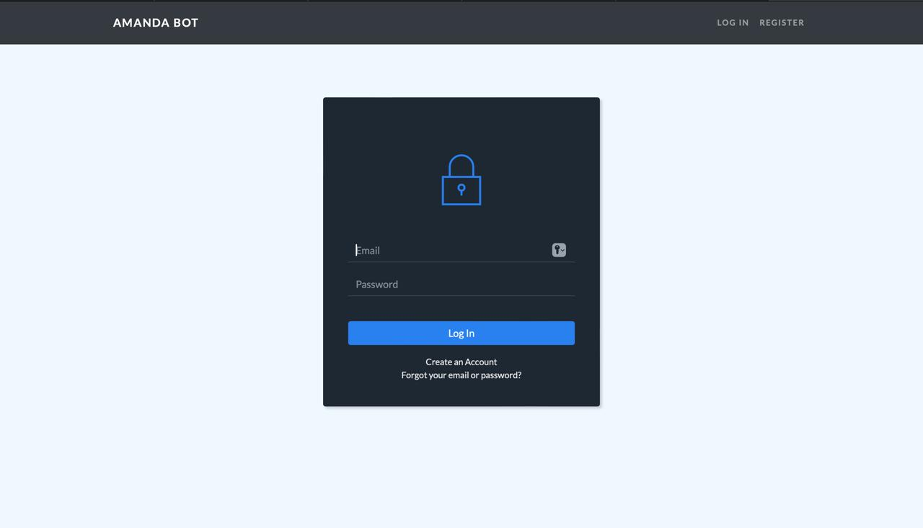

..

Slide 10
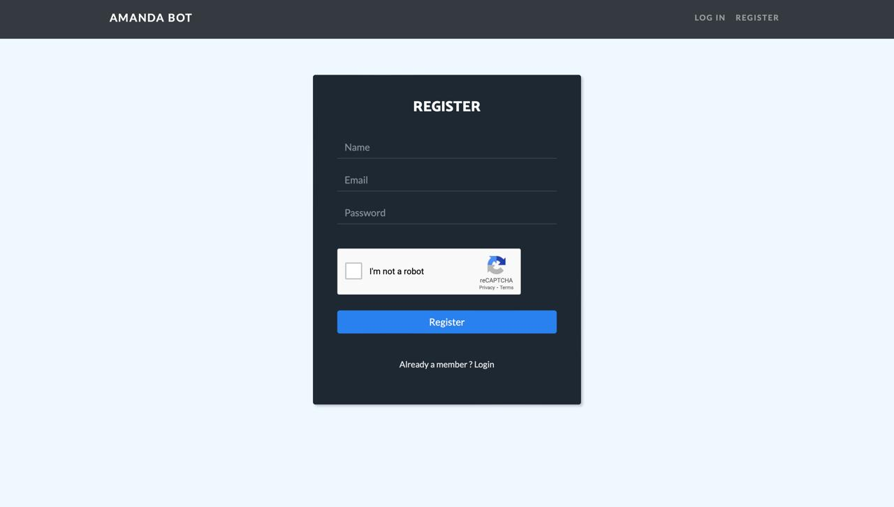

Slide 11
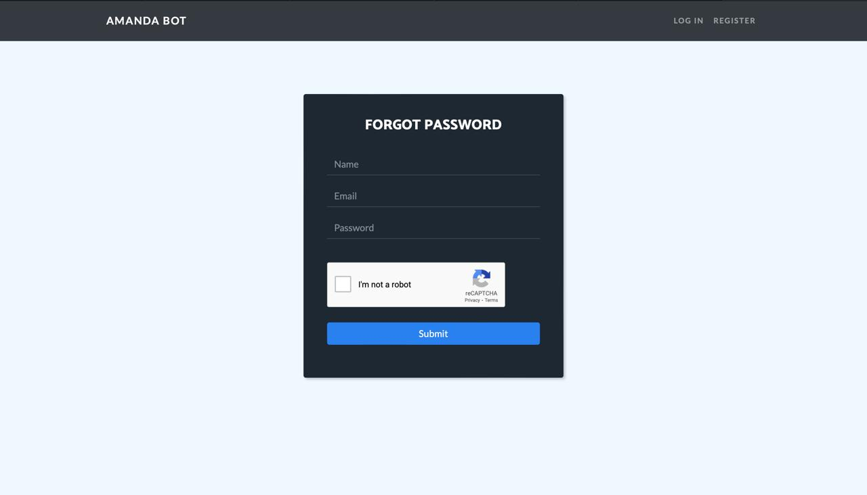

Slide 12
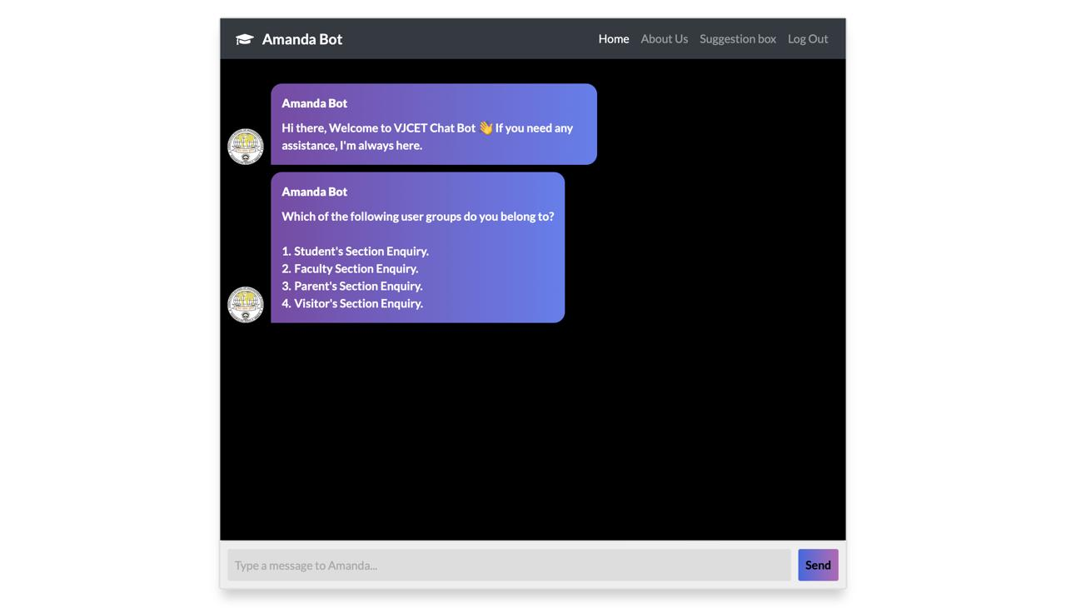


Slide 13

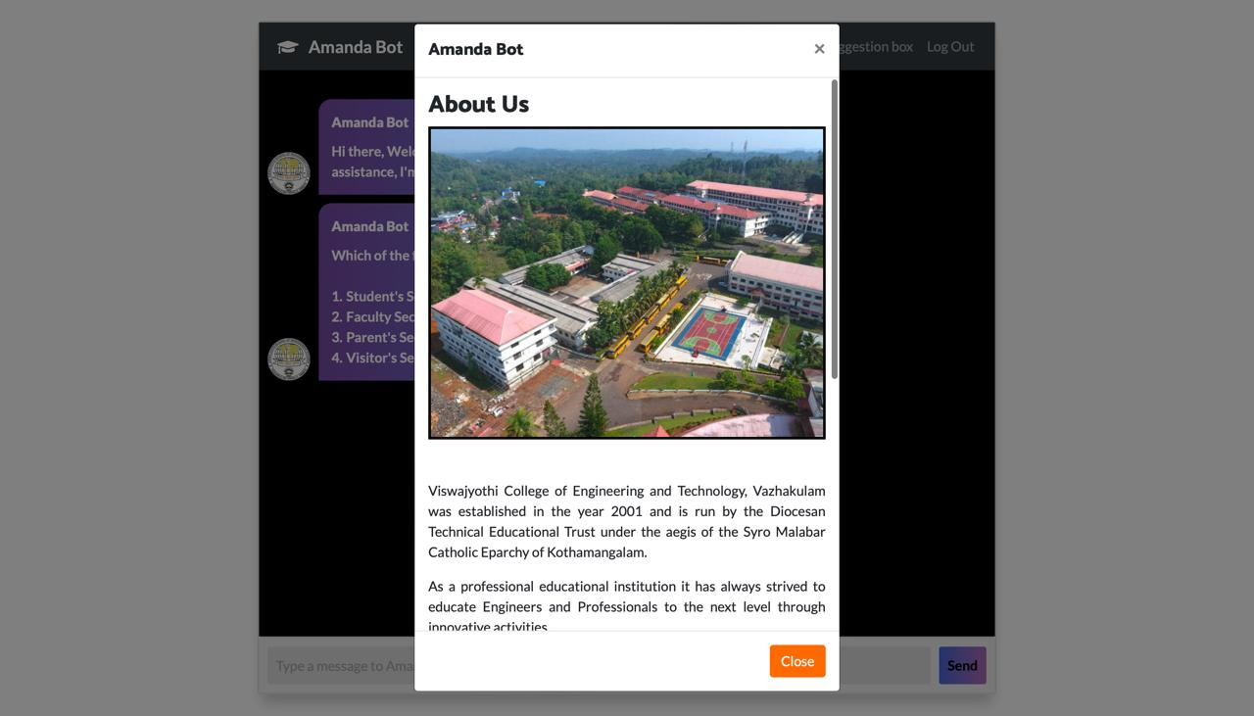

Slide 14
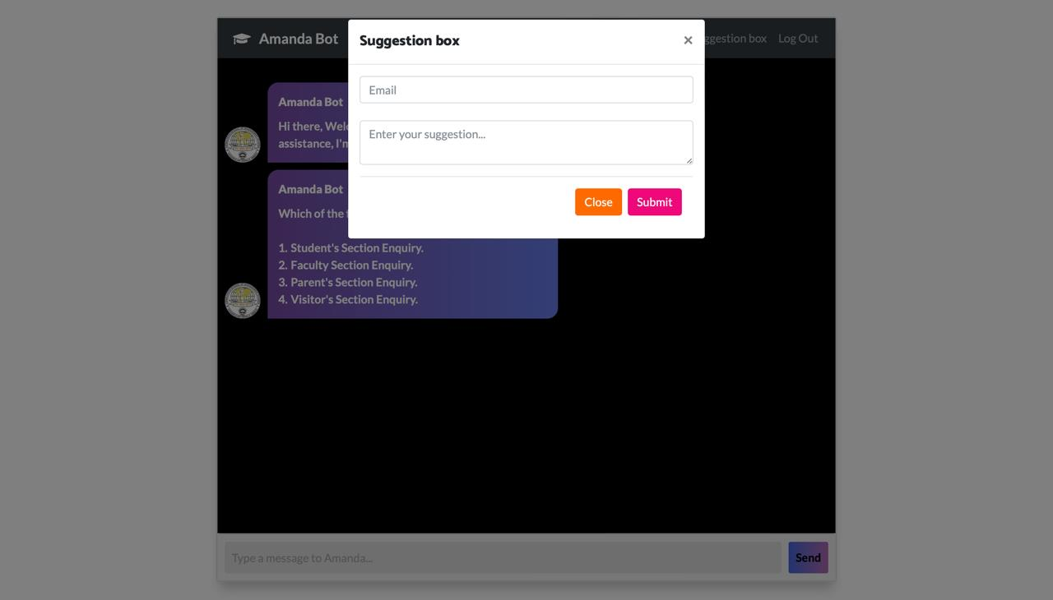

Slide 15
2. VALIDATION CHECK
1.Once users submit their credentials through the login form,Python verifies the entered information by querying the database.
2. It checks if the provided email and password match any records stored in the database.
3. This step ensures that only authorized users can access the system.
4. It confirms that the user is authenticated and can proceed further.
5. If not, it indicates that the provided credentials are invalid, and the user may be denied access or prompted to retry with correct credentials.
6. MySQL is used here as Database

Slide 16
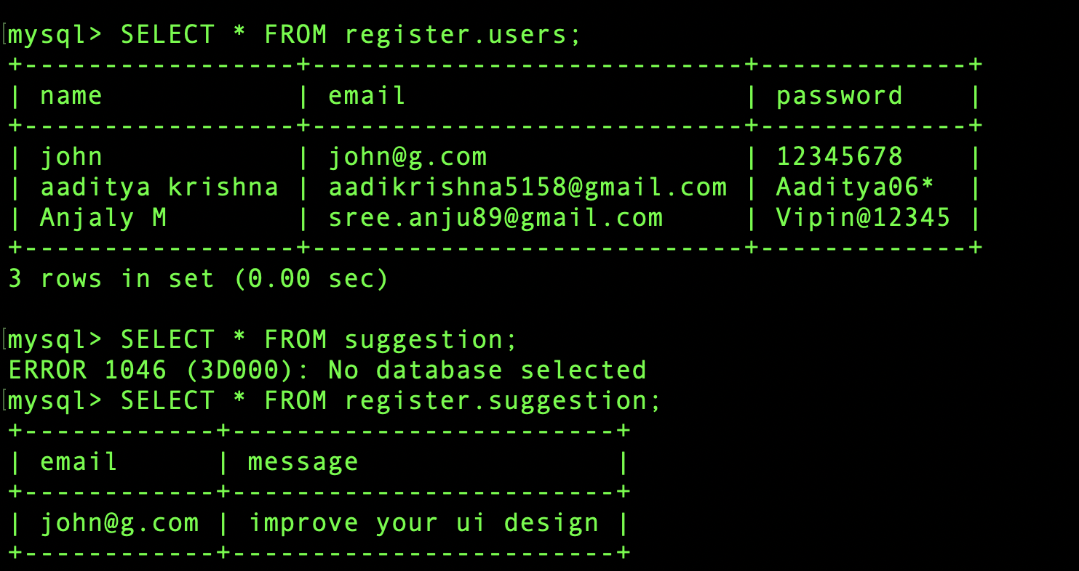

Slide 17
3.User input
Once authenticated, users can provide input through various forms or interfaces, such as submitting registration details, suggestions, or chatbot queries.
New users can create / register new account
User clients can gave their suggestions through suggestion box feature
User input refers to the data provided by users through various interfaces, such as forms, text fields, buttons, or other interactive elements in an application.
Users can pass queries in 2 ways:
Either by passing predefined commonly asked question
Or by free chat

Slide 18
4.Processing and query handling
Chatbot is preprocessed and trained using CHATTERBOT.TRAINER and LISTT
Chatbot Training: Training data (conversations) is typically provided to the ChatBot to teach it how to respond to different user inputs effectively.
User Interaction Training: The responses generated by the ChatBot are based on the user's input and the logic defined within the code. Over time, as the ChatBot interacts with users and receives feedback, it can continuously learn and improve its responses through a process similar to training.
User Interface Experience:The user interface elements, such as login, registration, and chat interaction, making it easier for users to navigate and interact with the application effectively.
Feedback Mechanism: This feature can get through suggestion box and feedback can be used to identify areas for improvement and refinement, contributing to the ongoing training and enhancement of the system.

Slide 19
5.RESPONSE GENERATION
Receive queries from user
Tokenize the words
Chat bot logic
Pattern Matching
Check the words using TAG
Get Response to chatbot object
Transfer Response to HTML by html request

Slide 20
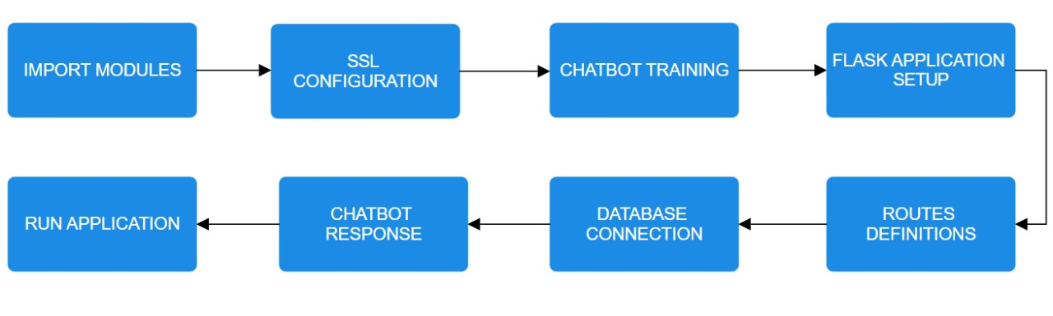
Flow of code

Slide 21
Packages used:
FLASK:The main Flask class used to create the Flask application instance.
render_template: Function used to render HTML templates.
request: Object representing the current HTTP request.
redirect: Function to redirect the user to a different URL.
flash: Function for displaying temporary messages to the user.
ReCaptcha: Extension for integrating Google reCAPTCHA with Flask applications.
mysql.connector: Module for connecting to MySQL databases.
ChatBot: Class representing a chatbot instance created using the ChatterBot library.
nltk: Natural Language Toolkit, a library for natural language processing.
ssl: Module providing access to Transport Layer Security (TLS) and Secure Socket Layer (SSL) cryptographic protocols.

Slide 22

Code Implementation
from flask import Flask, render_template, request, session, redirect, flash
from flask_recaptcha import ReCaptcha
import mysql.connector
import os
from chatterbot import ChatBot
from jinja2 import Markup
from chatterbot.trainers import ListTrainer
#import nltk
import ssl
try:
_create_unverified_https_context = ssl._create_unverified_context
except AttributeError:
pass
else:
ssl._create_default_https_context = _create_unverified_https_context

Slide 23
Code implementation
# nltk.download('stopwords')
bot = ChatBot('<b>Amanda Bot</b>')
bot = ChatBot(
'ChatBot for College Enquiry',
storage_adapter='chatterbot.storage.SQLStorageAdapter',
logic_adapters=[
{
'import_path': 'chatterbot.logic.BestMatch',
'default_response': "Hi there, Welcome to college chat bot 👋 If you need any assistance, I'm always here.Go ahead and write the number of any query. 😃✨<b><br><br> Which of the following user groups do you belong to? <br><br>1.&emsp;Student's Section Enquiry.</br>2.&emsp;Faculty Section Enquiry. </br>3.&emsp;Parent's Section Enquiry.</br>4.&emsp;Visitor's Section Enquiry.</br><br>",
'maximum_similarity_threshold': 0.90
}
],
database_uri='sqlite:///database.sqlite3'
)
trainer = ListTrainer(bot)

Slide 24
Code implementation
conversation = [
"Hi",
"Helloo!",
"Hey",
"what courses are available",
"computer engineering, electronics and computer science, Mechanical Engineering, Science and Humanities, AI & Data Science"
"How are you?",
"I'm good.</br> <br>Go ahead and write the number of any query. 😃✨ <br> 1.&emsp;Student's Section Enquiry.</br>2.&emsp;Faculty Section Enquiry. </br>3.&emsp;Parent's Section Enquiry.</br>4.&emsp;Visitor's Section Enquiry.</br>",
"Great",
"Go ahead and write the number of any query. 😃✨ <br> 1.&emsp;Student's Section Enquiry.</br>2.&emsp;Faculty Section Enquiry. </br>3.&emsp;Parent's Section Enquiry.</br>4.&emsp;Visitor's Section Enquiry.</br>",
"good",
"Go ahead and write the number of any query. 😃✨ <br> 2.&emsp;Faculty Section Enquiry. </br>3.&emsp;Parent's Section Enquiry.</br>4.&emsp;Visitor's Section Enquiry.</br>",

Slide 25
Code implementation
"4.4",
"<b > EXTRA-CURRICULAR <br>These are the top results:<br> <br>4.4.1 Events <br> 4.4.2 Institute Innovation Cell </b>",
"4.4.1",
"<b > 4.4.1 Events <br>The link to Events 👉 <a href=" 'http://www.frcrce.ac.in/index.php/students/events-new' ">Click Here</a> </b>",
"4.4.2",
"<b > 4.4.2 Institute Innovation Cell <br>The link to Institute Innovation Cell 👉<a href=" 'https://crceiic.github.io/' ">Click Here</a> </b>",
]
trainer.train(conversation)

Slide 26
Code implementation
app = Flask(__name__)
recaptcha = ReCaptcha(app)
app.secret_key=os.urandom(24)
app.static_folder = 'static'
app.config.update(dict(
RECAPTCHA_ENABLED = True,
RECAPTCHA_SITE_KEY = "6LdbAx0aAAAAAANl04WHtDbraFMufACHccHbn09L",
RECAPTCHA_SECRET_KEY = "6LdbAx0aAAAAAMmkgBKJ2Z9xsQjMD5YutoXC6Wee"
))
recaptcha=ReCaptcha()
recaptcha.init_app(app)
app.config['SECRET_KEY'] = 'cairocoders-ednalan'
conn=mysql.connector.connect(host='localhost',port='3306',user='root',password='root',database='register',auth_plugin='mysql_native_password')
cur=conn.cursor()

Slide 27
Code implementation
@app.route("/index")
def home():
if 'id' in session:
return render_template('index.html')
else:
return redirect('/')
@app.route('/')
def login():
return render_template("login.html")
@app.route('/register')
def about():
return render_template('register.html')

Slide 28
Code implementation
@app.route('/forgot')
def forgot():
return render_template('forgot.html')
@app.route('/login_validation',methods=['POST'])
def login_validation():
email=request.form.get('email')
password=request.form.get('password')
cur.execute("""SELECT * FROM `users` WHERE `email` LIKE '{}' AND `password` LIKE '{}'""".format(email,password))
users = cur.fetchall()
if len(users)>0:
session['id']=users[0][0]
flash('You were successfully logged in')
return redirect('/index')
else:
flash('Invalid credentials !!!')
return redirect('/')

Slide 29
Code implementation
@app.route('/add_user',methods=['POST'])
def register():
if recaptcha.verify():
flash('New User Added Successfully')
return redirect('/register')
else:
flash('Error Recaptcha')
return redirect('/register')

Slide 30
Code implementation
@app.route('/logout')
def logout():
session.pop('id')
return redirect('/')
@app.route("/get")
def get_bot_response():
userText = request.args.get('msg')
reply = bot.get_response(userText)
print(reply)
return str(reply)
if __name__ == "__main__":
app.run()

Slide 31
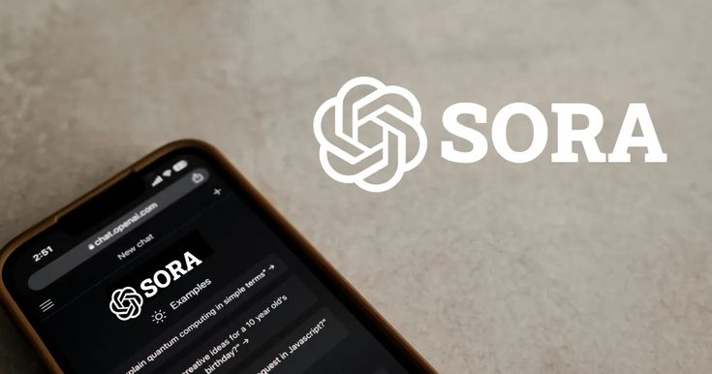
Conclusion
The college enquiry chatbot developed using Python and Flask provides an interactive platform for users to obtain
information about various aspects of the college. Here's a conclusion summarizing its key features and functionalities:
1. Interactive Interface: Users communicate via text messages.
2. Information Retrieval: Inquire about college topics.
3. Structured Responses: Clear, organized answers.
4. User Authentication: Secure login and personalized features.
5. User Feedback: Offer suggestions for improvement.
6. Database Integration: Stores user data in MySQL.
7. Security Measures: Includes reCAPTCHA verification.
Overall, the college enquiry chatbot provides a convenient and efficient way for users to access information and
services related to the college, enhancing communication and engagement within the college community.

Slide 32


